Slide 1
CGB1201 – JAVA PROGRAMMING
Department of Artificial Intelligence and Data Science
Academic Year: 2024 – 2025 (Odd Semester)
Register Number : 2303811724321077
Name : NETHAJI J
Year : II
Semester : III
Section : B
Date : 3/12/2024

Slide 2
Title of the Project
DISASTER MANAGEMENT SYSTEM

Slide 3
Problem Identification
Traditional systems struggle to process and update disaster information dynamically, leading to delays.
Absence of event-driven programming makes it difficult to handle user inputs like adding or retrieving data efficiently.
Ensuring seamless, intuitive interaction for users is critical but often overlooked in conventional systems.
Handling increasing user inputs or events simultaneously may overwhelm non-event-driven systems.

Slide 4
Objective
To provide an efficient platform for managing disaster reports and rescue team data.
To simplify the process of adding, viewing, and retrieving critical disaster-related information.
To enable real-time updates through an intuitive message display area.
To support timely decision-making during emergencies.
To enhance coordination between rescue teams and disaster management personnel.
To improve disaster preparedness and response efforts.

Slide 5
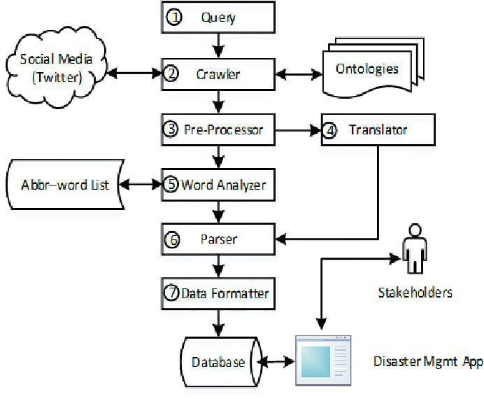
Proposed Architecture

Slide 6
Java Programming - Concepts Used
COLLECTION FRAMEWORK (ARRAYLIST): The Disaster Management System leverages Java's ArrayList for efficient storage and management of disaster and rescue team information. ArrayList's dynamic resizing and methods for adding, removing, and retrieving elements support scalability. For instance, new disasters are added dynamically, and the list can be retrieved or filtered as needed, ensuring performance even with growing data. This flexibility makes it ideal for managing real-time updates in disaster scenarios.

Slide 7
Java Programming - Concepts Used
EVENT-DRIVEN PROGRAMMING: The Disaster Management System uses AWT components like buttons and text fields for event-driven programming, with ActionListener handling user interactions. For example, clicking "Add Disaster" triggers input collection and updates the message board, while "View Disasters" dynamically displays reports. This approach ensures interactivity, seamless user engagement, and efficient real-time system responses.

Slide 8
List of Modules
Disaster Information Management Module
Rescue Team Management Module
Real-time Communication Module
Resource Allocation And Management Module
Reporting And Analytics Module

Slide 9
Module Description
Disaster Information Management Module: The disaster module tracks natural events like earthquakes, floods, or fires, including their location, date, and severity. Data is entered manually, imported, or updated in real-time via news or weather service integration.
Rescue Team Management Module: The module manages rescue team details, including name, members, skills, availability, and location. It ensures real-time tracking to prevent over-assignment or underutilization, enabling timely and effective disaster response.

Slide 10
Module Description (Cont..)
Real-time Communication Module: This module sends notifications on new disasters, status updates, and rescue deployments via email, SMS, or app alerts. It ensures timely, accurate communication to support swift response efforts.
Resource Allocation And Management Module: This module tracks and allocates critical resources like medical kits, food, and rescue vehicles in real-time, ensuring efficient distribution to disaster zones and preventing resource wastage.
Reporting And Analytics Module: This module generates reports on disaster data and response metrics, offering insights to improve future operations.

Slide 11
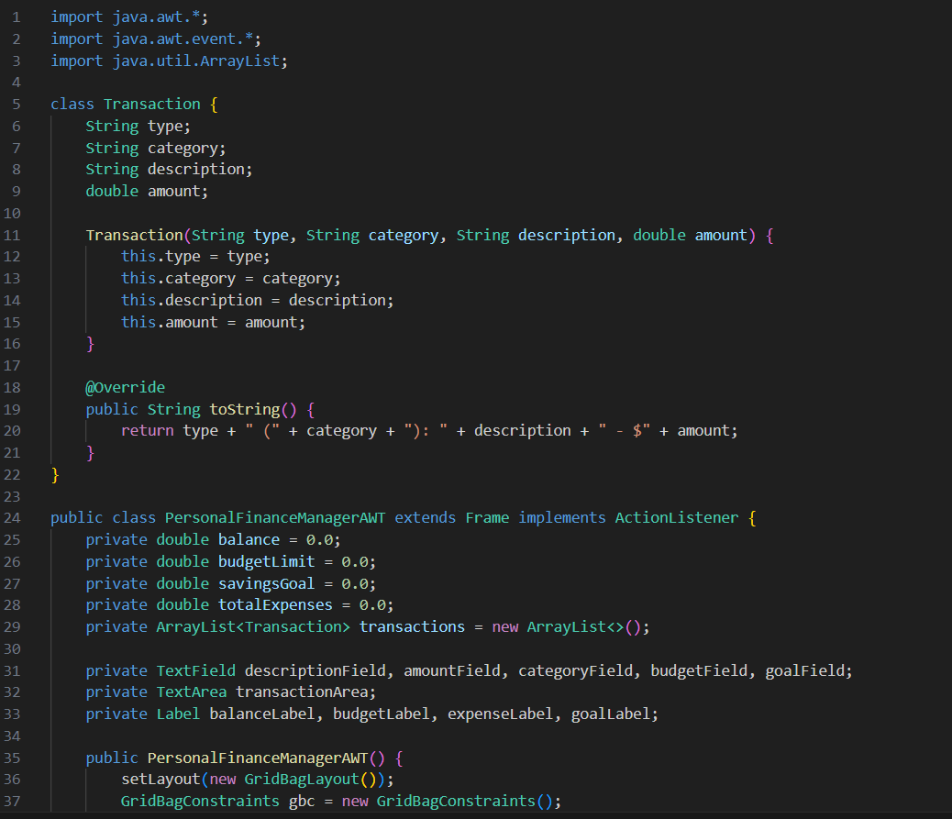
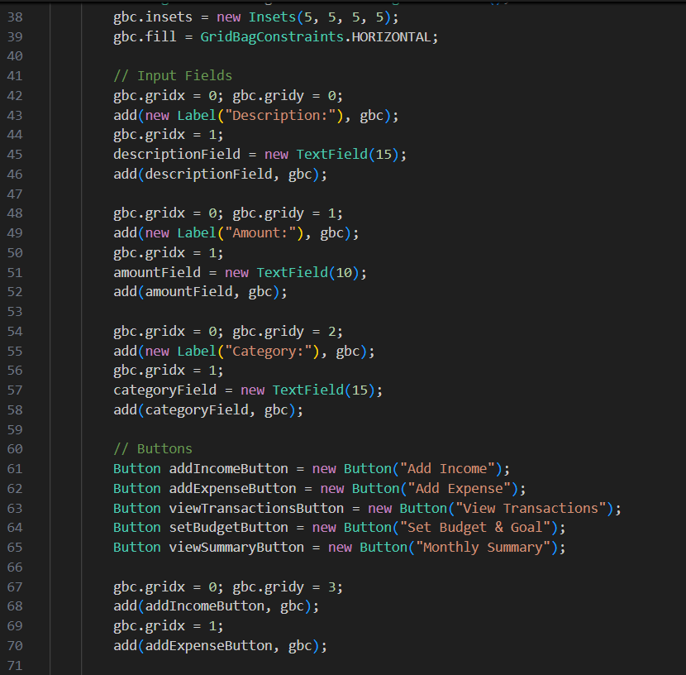
Source Code

Slide 12
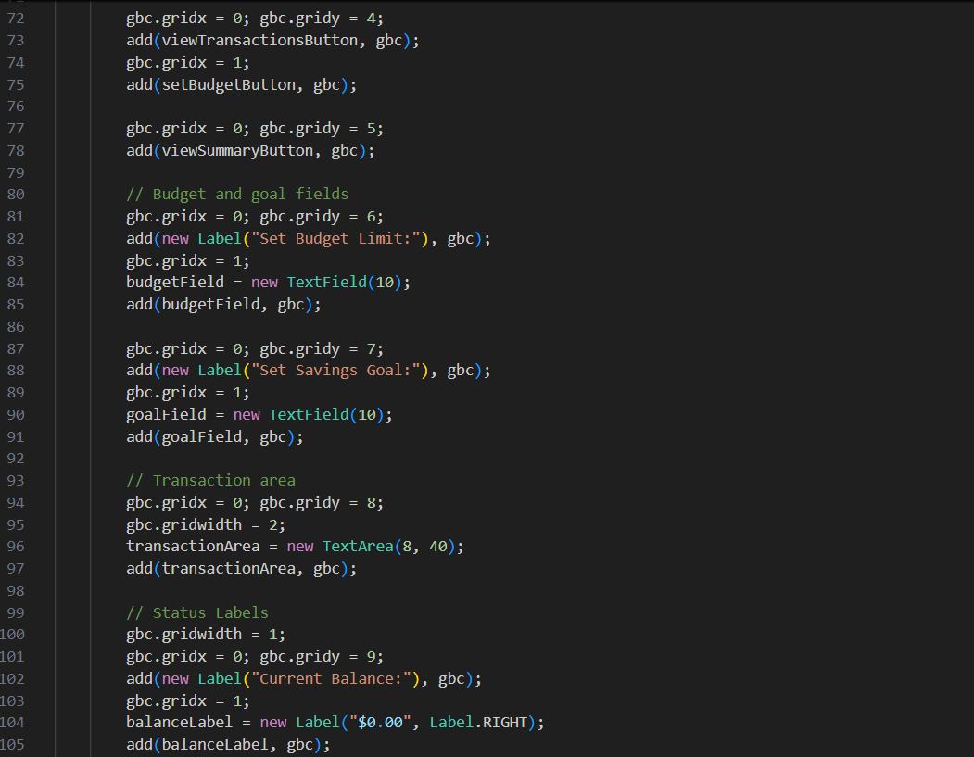
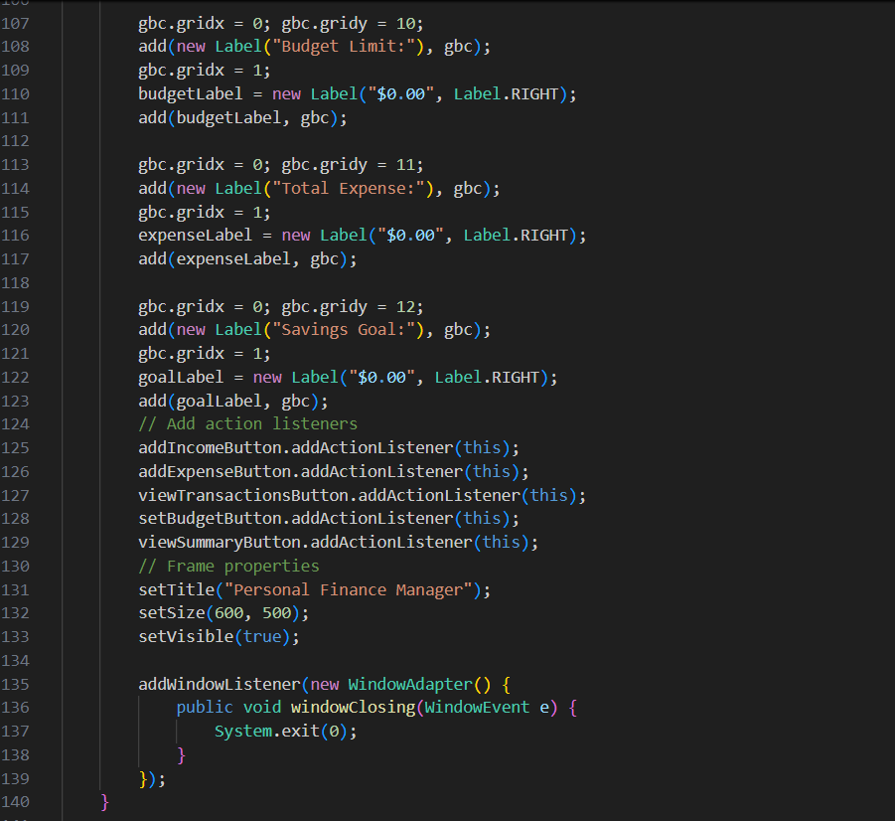
Source Code

Slide 13
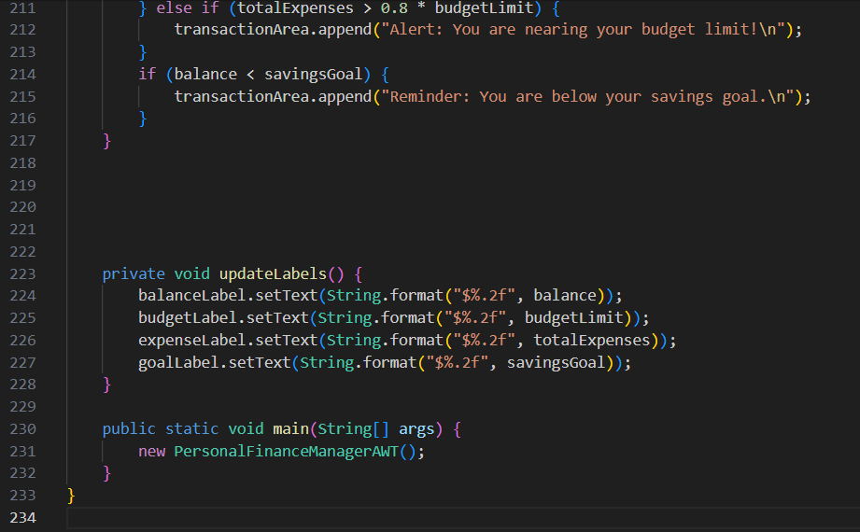
Source Code

Slide 14
Results

Slide 15
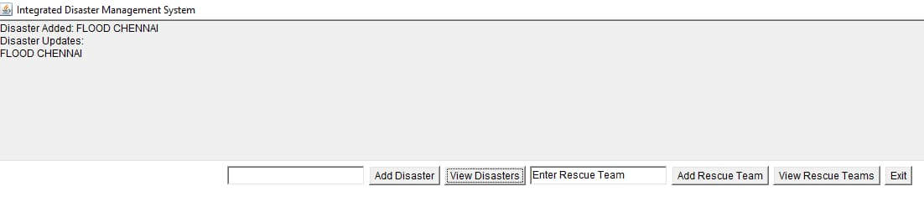
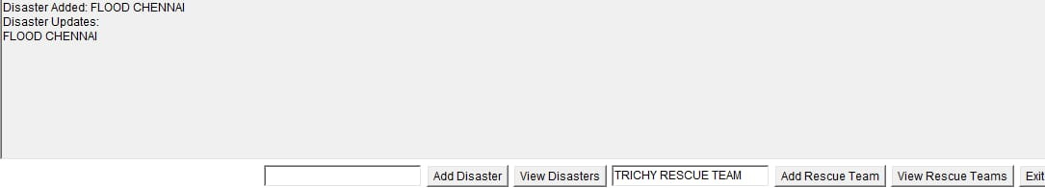
Results

Slide 16
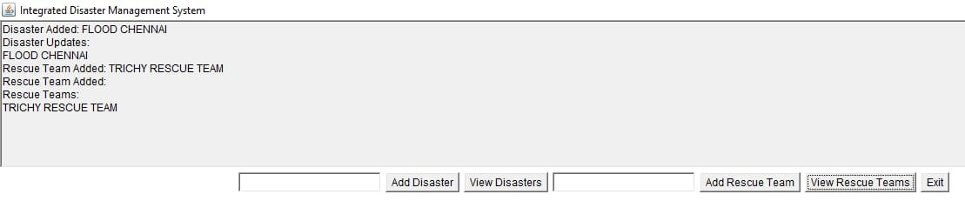
Results

Slide 17
Conclusion
The Disaster Management System integrates key modules for efficient disaster response, including disaster data management, rescue team coordination, resource allocation, and real-time communication.
It ensures rapid deployment of skilled teams, efficient resource use, and keeps all stakeholders informed for swift action.
Keeps all stakeholders informed with timely notifications, enabling swift action and coordination.

Slide 18
Thank You
Any queries???

